Slide 1
IDENTITY SERVER 4
Using openid connect and oauth2 for security

Slide 2
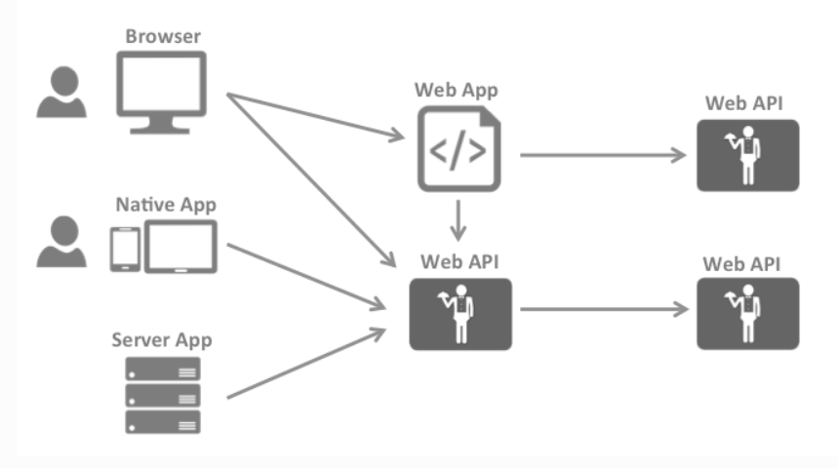
most common interactions

Slide 3
most common interactions
Browsers communicate with web applications
Web applications communicate with web APIs (sometimes on their own, sometimes on behalf of a user)
Browser-based applications communicate with web APIs
Native applications communicate with web APIs
Server-based applications communicate with web APIs
Web APIs communicate with web APIs (sometimes on their own, sometimes on behalf of a user)

Slide 4
Common need
Typically each and every layer (front-end, middle-tier and back-end) has to protect resources and implement authentication and/or authorization – often against the same user store.
Outsourcing these fundamental security functions to a security token service prevents duplicating that functionality across those applications and endpoints.

Slide 5
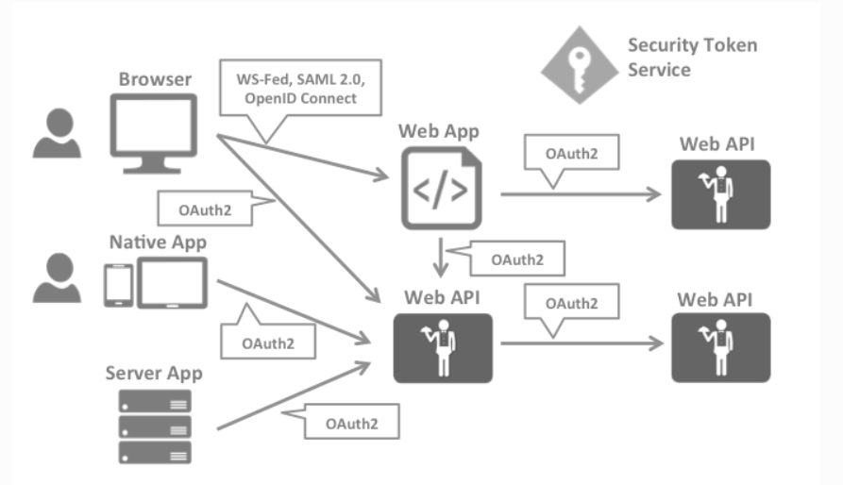
Change in architecture

Slide 6
Two distinct security concerns
Authentication
API Access

Slide 7
a. authentication
Authentication is needed when an application needs to know the identity of the current user
Typically these applications manage data on behalf of that user and need to make sure that this user can only access the data for which he is allowed
The most common authentication protocols are SAML2p, WS-Federation and OpenID Connect – SAML2p being the most popular and the most widely deployed

Slide 8
Openid connect
OpenID Connect is the newest of the three, but is considered to be the future because it has the most potential for modern applications.
It was built for mobile application scenarios right from the start and is designed to be API friendly.

Slide 9
b. Api access
Applications have two fundamental ways with which they communicate with APIs – using the application identity, or delegating the user’s identity.
Sometimes both methods need to be combined.
OAuth2 is a protocol that allows applications to request access tokens from a security token service and use them to communicate with APIs
This delegation reduces complexity in both the client applications as well as the APIs since authentication and authorization can be centralized

Slide 10
OpenID Connect and OAuth 2.0
OpenID Connect and OAuth 2.0 are very similar – in fact OpenID Connect is an extension on top of OAuth 2.0
The two fundamental security concerns, authentication and API access, are combined into a single protocol - often with a single round trip to the security token service.
Combination of OpenID Connect and OAuth 2.0 is the best approach to secure modern applications for the foreseeable future
IdentityServer4 is an implementation of these two protocols and is highly optimized to solve the typical security problems of today’s mobile, native and web applications

Slide 11
Identity server
IdentityServer is middleware that adds the spec compliant OpenID Connect and OAuth 2.0 endpoints to an arbitrary ASP.NET Core application
Typically, you build (or re-use) an application that contains a login and logout page (and maybe consent - depending on your needs) and the IdentityServer middleware adds the necessary protocol heads to it, so that client applications can talk to it using those standard protocols

Slide 12
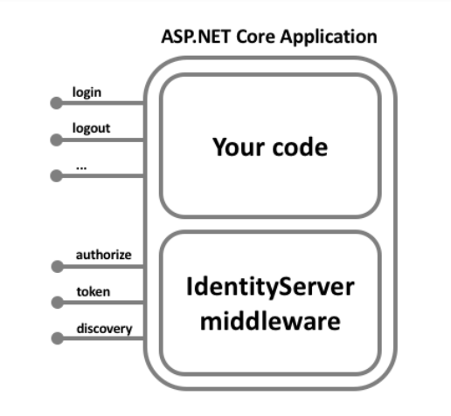
Identity server

Slide 13
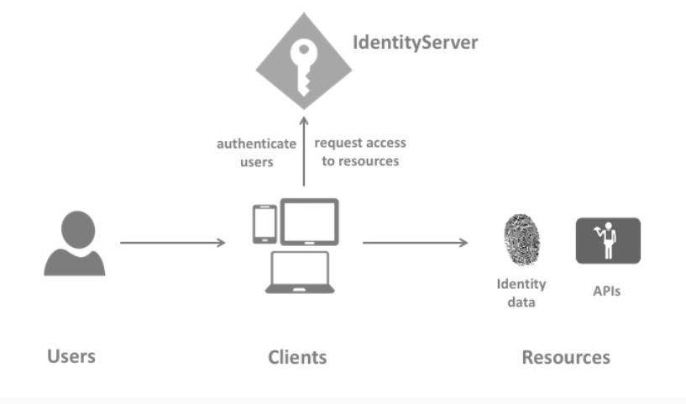
terminology
IdentityServer
User
Client
Resources
Identity token
Access token

Slide 14
Terminology: Identity server
IdentityServer is an OpenID Connect provider - it implements the OpenID Connect and OAuth 2.0 protocols
In a nutshell: a piece of software that issues security tokens to clients

Slide 15
Identity server and its responsibilities
protect your resources
authenticate users using a local account store or via an external identity provider
provide session management and single sign-on
manage and authenticate clients
issue identity and access tokens to clients
validate tokens

Slide 16
Terminology: User and client
A user is a human that is using a registered client to access resources
A client is a piece of software that requests tokens from IdentityServer - either for authenticating a user (requesting an identity token) or for accessing a resource (requesting an access token)
A client must be first registered with IdentityServer before it can request tokens.
Examples: web applications, native mobile or desktop applications, SPAs, server processes etc.

Slide 17
Terminology: Resources
Resources are something you want to protect with IdentityServer - either identity data of your users, or APIs
Every resource has a unique name - and clients use this name to specify to which resources they want to get access to
Identity data: Identity information (aka claims) about a user, e.g. name or email address
APIs: APIs resources represent functionality a client wants to invoke - typically modelled as Web APIs, but not necessarily

Slide 18
Terminology: Identity token
An identity token represents the outcome of an authentication process.
It contains at a bare minimum an identifier for the user (called the sub aka subject claim) and information about how and when the user authenticated.
It can contain additional identity data

Slide 19
Terminology: Access token
An access token allows access to an API resource.
Clients request access tokens and forward them to the API.
Access tokens contain information about the client and the user (if present).
APIs use that information to authorize access to their data

